Slide 1
Introduction to Software Engineering
Dr. Junaid Akram
Assistant Professor, Department of Computer Science COMSATS (Lahore)
PhD (Software Engineering) Tsinghua University
PostDoc (Software Testing) University of Luxembourg

Slide 2
Course Info
This course introduces the different software process models by illustrating its phases and principles of software engineering. Topics include: Overview of Software Engineering Software Process Models Requirement Engineering Concepts Software Design Design Modeling Software Quality Engineering Software Project Management Software Maintenance and Software Evolution

Slide 3
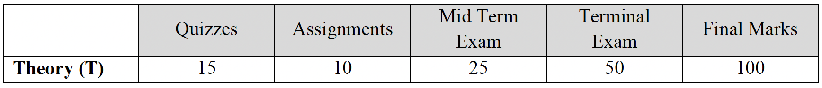
Course Assessment
Grading Policy: The minimum passing marks for each course is 50%
Attendance Policy: Every student must attend 80% of the lectures
Missing Exam: No makeup exam will be given for final exam under any circumstance
Plagiarism Policy: Plagiarism, copying and any other dishonest behavior is prohibited by the rules and regulations of CUI. Violators will face serious consequences

Slide 4
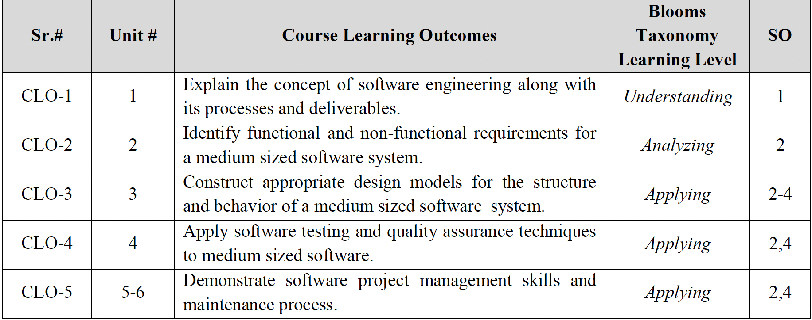
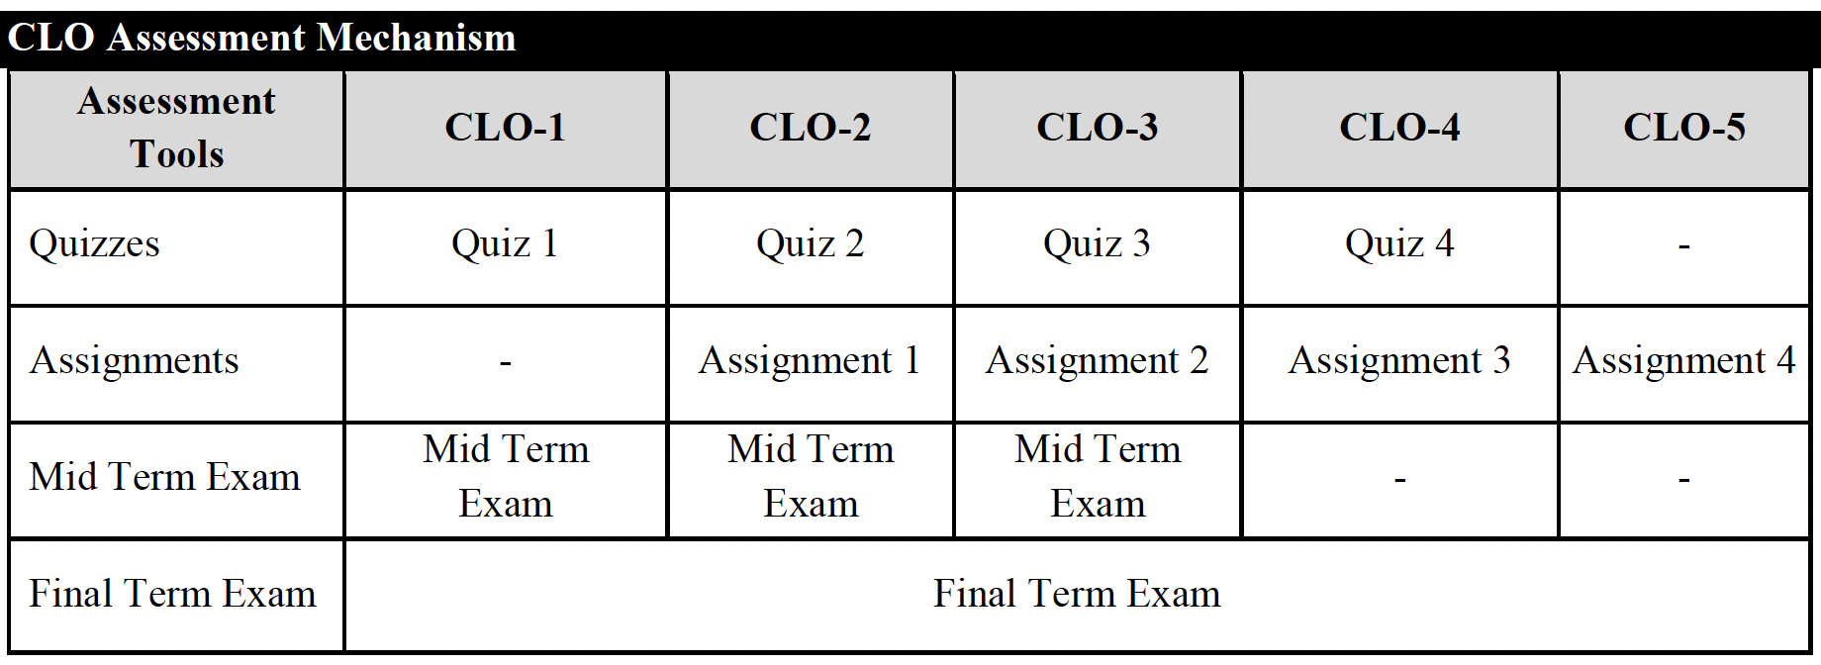
Course Learning Outcomes

Slide 5
References and Readings
Textbook
• Pressman, Roger S.; Maxim, Bruce; Software Engineering: A Practitioner's Approach 9th edition. McGraw Hill Higher Education Press, 2020
Reference Books
• Sommerville, Ian. Engineering Software Products: An Introduction to Modern Software Engineering. Pearson. 1st Edition. 2020. (ISBN13: 978-0135210642).
• Dooley, John F. F.; Software Development, Design and Coding: With Patterns, Debugging, Unit Testing, and Refactoring 2nd ed. Edition. Apress, 2017 (ISBN13: 978-1484231524)
• Software Engineering with UML, Bhuyan Unhelkar, CRC Press, 2018.

Slide 6
What is Software?
The product that software professionals build and then support over the long term.
Software encompasses:
instructions (computer programs) that when executed provide desired features, function, and performance;
(2) data structures that enable the programs to adequately store and manipulate information and
(3) documentation that describes the operation and use of the programs.

Slide 7
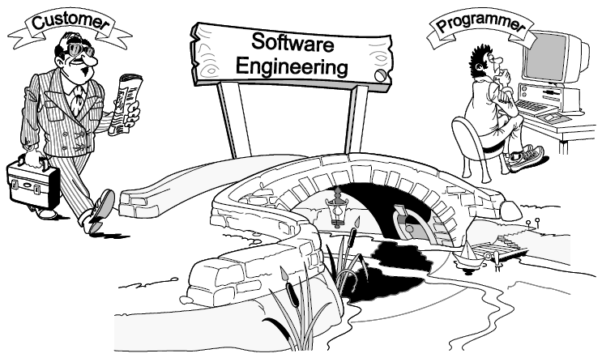
Software Engineering Definition
[Software engineering is] the establishment and use of sound engineering principles in order to obtain economically software that is reliable and works efficiently on real machines.

Slide 8
Software products
Generic products
Stand-alone systems that are marketed and sold to any customer who wishes to buy them.
Examples – PC software such as editing, graphics programs, project management tools; CAD software; software for specific markets such as appointments systems for dentists.
Customized products
Software that is commissioned by a specific customer to meet their own needs.
Examples – embedded control systems, air traffic control software, traffic monitoring systems.

Slide 9
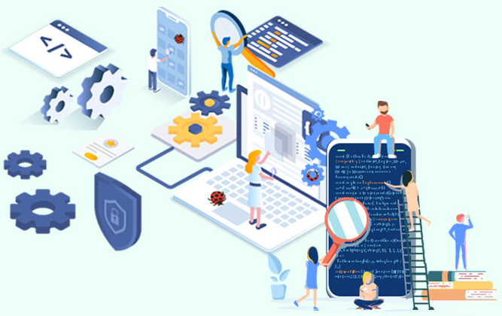
Why Software is Important?
The economies of ALL developed nations are dependent on software.
More and more systems are software controlled ( transportation, medical, telecommunications, military, industrial, entertainment,)
Software engineering is concerned with theories, methods and tools for professional software development.
More and more, individuals and society rely on advanced software systems. We need to be able to produce reliable and trustworthy systems economically and quickly.

Slide 10
Software Applications
1. System software: such as compilers, editors, file management utilities
2. Application software: stand-alone programs for specific needs.
3. Engineering/scientific software: Characterized by “number crunching”algorithms. such as automotive stress analysis, molecular biology, orbital dynamics etc
4. Embedded software resides within a product or system. (key pad control of a microwave oven, digital function of dashboard display in a car)
5. Product-line software focus on a limited marketplace to address mass consumer market. (word processing, graphics, database management)
6. WebApps (Web applications) network centric software. As web 2.0 emerges, more sophisticated computing environments is supported integrated with remote database and business applications.
7. AI software uses algorithm to solve complex problem. Robotics, expert system, pattern recognition game playing

Slide 11
FAQ about Software Engineering
Question | Answer
What is software? | Computer programs, data structures and associated documentation. Software products may be developed for a particular customer or may be developed for a general market.
What are the attributes of good software? | Good software should deliver the required functionality and performance to the user and should be maintainable, dependable and usable.
What is software engineering? | Software engineering is an engineering discipline that is concerned with all aspects of software production.
What is the difference between software engineering and computer science? | Computer science focuses on theory and fundamentals; software engineering is concerned with the practicalities of developing and delivering useful software.
What is the difference between software engineering and system engineering? | System engineering is concerned with all aspects of computer-based systems development including hardware, software and process engineering. Software engineering is part of this more general process.

Slide 12
Essential attributes of good software
Product characteristic | Description
Maintainability | Software should be written in such a way so that it can evolve to meet the changing needs of customers. This is a critical attribute because software change is an inevitable requirement of a changing business environment.
Dependability and security | Software dependability includes a range of characteristics including reliability, security and safety. Dependable software should not cause physical or economic damage in the event of system failure. Malicious users should not be able to access or damage the system.
Efficiency | Software should not make wasteful use of system resources such as memory and processor cycles. Efficiency therefore includes responsiveness, processing time, memory utilisation, etc.
Acceptability | Software must be acceptable to the type of users for which it is designed. This means that it must be understandable, usable and compatible with other systems that they use.

Slide 13
A Layered Technology
Software Engineering
tools
methods
process model
a “quality” focus
Any engineering approach must rest on organizational commitment to quality which fosters a continuous process improvement culture.
Process layer as the foundation defines a framework with activities for effective delivery of software engineering technology. Establish the context where products (model, data, report, and forms) are produced, milestone are established, quality is ensured and change is managed.
Method provides technical how-to’s for building software. It encompasses many tasks including communication, requirement analysis, design modeling, program construction, testing and support.
Tools provide automated or semi-automated support for the process and methods.

Slide 14
Software Process
A process is a collection of activities, actions and tasks that are performed when some work product is to be created. It is not a rigid prescription for how to build computer software. Rather, it is an adaptable approach that enables the people doing the work to pick and choose the appropriate set of work actions and tasks.
Purpose of process is to deliver software in a timely manner and with sufficient quality to satisfy those who have sponsored its creation and those who will use it.

Slide 15
Five Activities of a Generic Process framework
Communication: communicate with customer to understand objectives and gather requirements
Planning: creates a “map” defines the work by describing the tasks, risks and resources, work products and work schedule.
Modeling: Create a “sketch”, what it looks like architecturally, how the constituent parts fit together and other characteristics.
Construction: code generation and the testing.
Deployment: Delivered to the customer who evaluates the products and provides feedback based on the evaluation.
These five framework activities can be used to all software development regardless of the application domain, size of the project, complexity of the efforts etc, though the details will be different in each case.
For many software projects, these framework activities are applied iteratively as a project progresses. Each iteration produces a software increment that provides a subset of overall software features and functionality.

Slide 16
Umbrella Activities
Complement the five process framework activities and help team manage and control progress, quality, change, and risk.
Software project tracking and control: assess progress against the plan and take actions to maintain the schedule.
Risk management: assesses risks that may affect the outcome and quality.
Software quality assurance: defines and conduct activities to ensure quality.
Technical reviews: assesses work products to uncover and remove errors before going to the next activity.
Measurement: define and collects process, project, and product measures to ensure stakeholder’s needs are met.
Software configuration management: manage the effects of change throughout the software process.
Reusability management: defines criteria for work product reuse and establishes mechanism to achieve reusable components.
Work product preparation and production: create work products such as models, documents, logs, forms and lists.

Slide 17
Understand the Problem
Who has a stake in the solution to the problem? That is, who are the stakeholders?
What are the unknowns? What data, functions, and features are required to properly solve the problem?
Can the problem be compartmentalized? Is it possible to represent smaller problems that may be easier to understand?
Can the problem be represented graphically? Can an analysis model be created?

Slide 18
Plan the Solution
Have you seen similar problems before? Are there patterns that are recognizable in a potential solution? Is there existing software that implements the data, functions, and features that are required?
Has a similar problem been solved? If so, are elements of the solution reusable?
Can sub-problems be defined? If so, are solutions readily apparent for the sub-problems?
Can you represent a solution in a manner that leads to effective implementation? Can a design model be created?
Does the solutions conform to the plan? Is source code traceable to the design model?
Is each component part of the solution provably correct? Has the design and code been reviewed, or better, have correctness proofs been applied to algorithm?
Is it possible to test each component part of the solution? Has a reasonable testing strategy been implemented?
Does the solution produce results that conform to the data, functions, and features that are required? Has the software been validated against all stakeholder requirements?

Slide 19
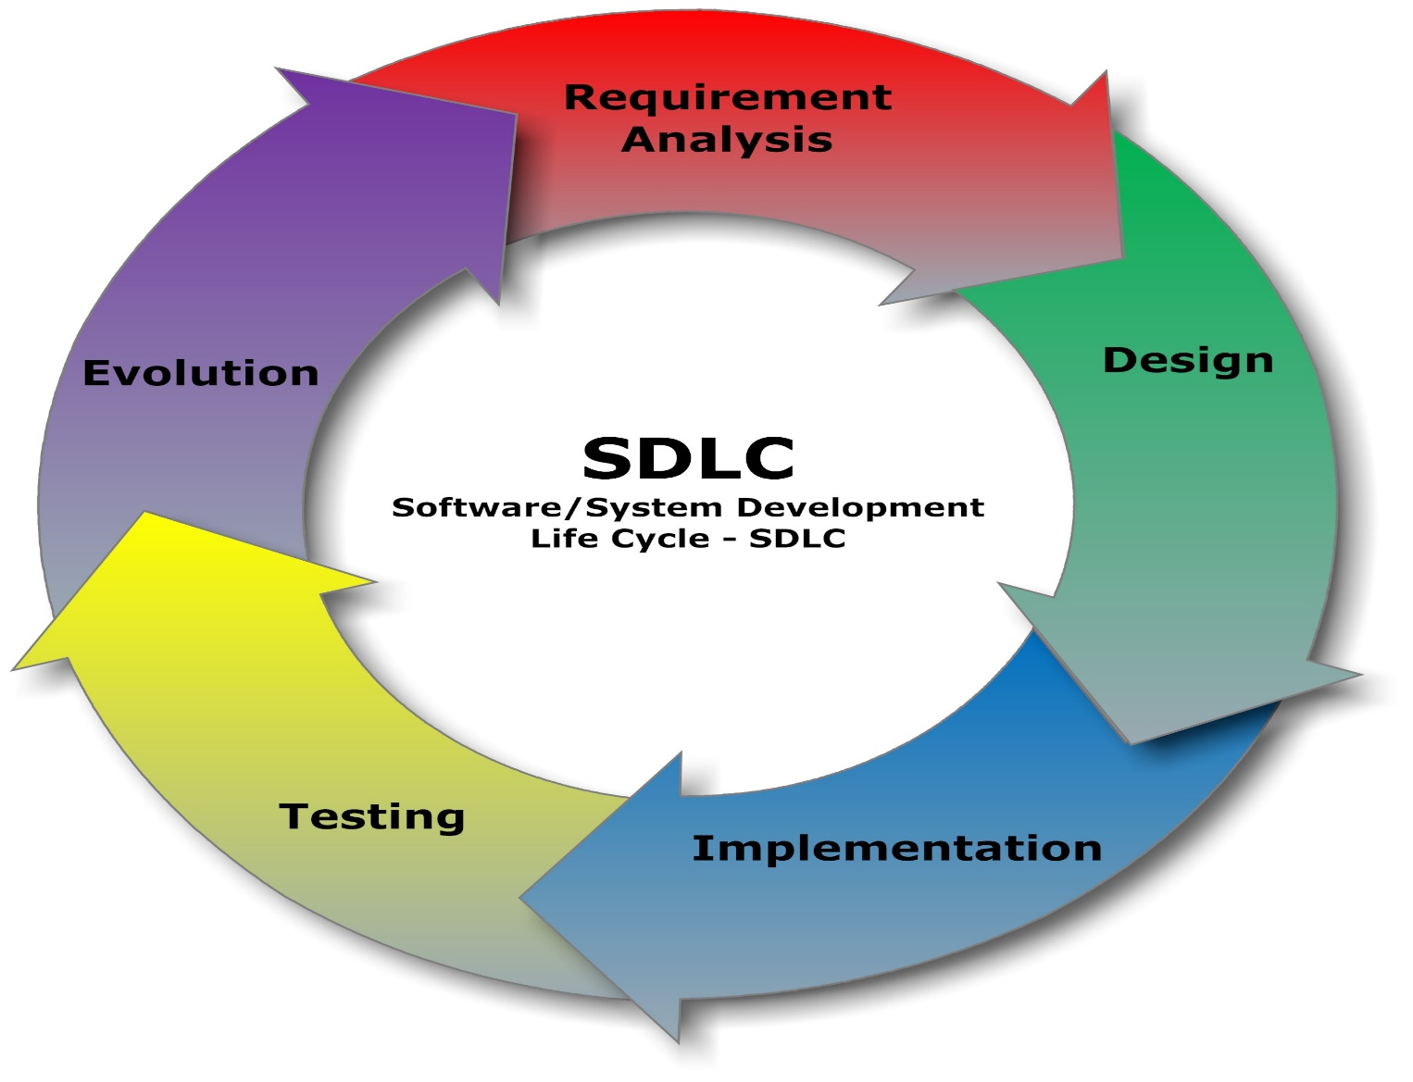
What are the main phases in the lifecycle of a software product?

Slide 20
Software Lifecycle Context (Waterfall Model)
Requirements
Design
Implementation
Integration
Validation
Deployment

Slide 21
Requirements Phase “What I need, not what I said I needed”
Specifications Phase What the developer wants to know:
What does the product do?
What are the constraints on the product?
Acceptance criteria
Frequent problems with a spec:
ambiguous
incomplete
contradictory
Specifications testing
SQA
reviews

Slide 22
Design Phase How does the product do what it is supposed to do?
Analysis of the problem
Structured analysis : decomposing problem by how data is manipulated (acted upon)
Object-oriented analysis: decomposing problem by how data is represented
Developer must make design decisions about:
algorithms
data representations
I/O interfaces
data flow
modules
Design testing
traceability

Slide 23
Implementation Phase
Code
Documentation
Tests
Implementation testing
- desk checking
- test cases
- reviews

Slide 24
Integration Phase Putting it all together
Composition order
Integration testing
interfaces
Testing
- does it meet the specs?
- product testing by SQA
- acceptance testing by customer

Slide 25
Maintenance Phase
Maintenance testing
- changes
regression testing
Why?
operation
documentation
turnover
Kinds of maintenance
Corrective
Adaptive
Perfective
Preventive

Slide 26
Need to Test
Vulnerabilities always exist….
Because the software often rushed to the market….
And it was developed by people….
And people do make mistakes….
Which allow attackers to attack and compromise the systems….
All an attacker need is a small weakness or a flaw in your system to exploit

Slide 27
Testing Testing cannot show the absence of defects, it can only show that software defects are present.
Testing is a process of executing a program with the intent of finding an error.
A good test case is one that has a high probability of finding an as yet undiscovered error.
A successful test is one that uncovers an as yet undiscovered error.

Slide 28
Testing Methods
Black-box testing
Knowing the specified function that a product has been designed to perform, tests can be conducted that demonstrate each function is fully operational.
White-box or glass-box testing
Knowing the internal workings of a product, tests can be conducted to ensure that "all the gears mesh".
independent paths at least once
logical decisions both true and false
loops
internal data structures

Slide 29
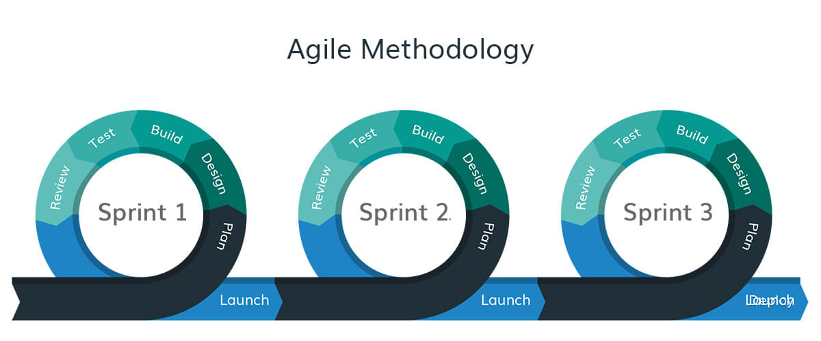
Testing in Current Century
Today’s software market :
is much bigger , is more competitive, has more users
Embedded Control Applications
airplanes, air traffic control
spaceships
watches
Agile processes increased pressure on testers
Tests are key to functional requirements
Industry is going through a revolution in what testing means to the success of software products
memory seats
DVD players
garage door openers
ovens
remote controllers
cell phones & PDAs

Slide 30

What Types of Testing Are There?
Functional Testing types include:
Unit Testing
Integration Testing
System Testing
Smoke Testing
Interface Testing
Regression Testing
Beta/Acceptance Testing
Non-Functional Testing types include:
Performance Testing
Load Testing
Volume Testing
Security Testing
Compatibility Testing
Installation Testing
Recovery Testing
Reliability Testing
Usability Testing
Which Testing type has more importance and why ?
40 Testing Types are mentioned here
https://www.softwaretestinghelp.com/types-of-software-testing/

Slide 31
Development Methods & Techniques
Development Methods & Techniques
System
Engineering
Requirements
Analysis
Design
Software
Implementation
Testing
Integration
Maintenance
Verification & Validation
Management Methods & Techniques
Project Planning
Project Tracking & Oversight
Quality Assurance
Configuration Management
Notes:
This chart restates the basic problem solving flow to software development methods and techniques. Systems engineering and requirements analysis is the “what,” design is the “how,” implementation is the “do,” and testing and integration is the “test.” During product use, maintenance may be required.
The software engineering principles reviewed earlier are incorporated into various software engineering methods and techniques. The principle of rigor and formality will require an adoption of appropriate methods to define requirements and design the system. Modularity, abstraction, and generality will be applied to tame the complexity of the design and make sure the design is understandable. Finally, anticipation of change and incrementality allow the designing of systems that can easily evolve.
Software engineering methods provide the technical "how to's" for building software. Each one of these software development activities will be defined in the slides to follow with the steps in each activity specified and shown with a sample technique.
Wind tunnels, aeronautic simulators, and space flight instruments are examples of types of applications that probably need to implement each of these development activities. However, your application area may only require a subset of these development activities.

Slide 32
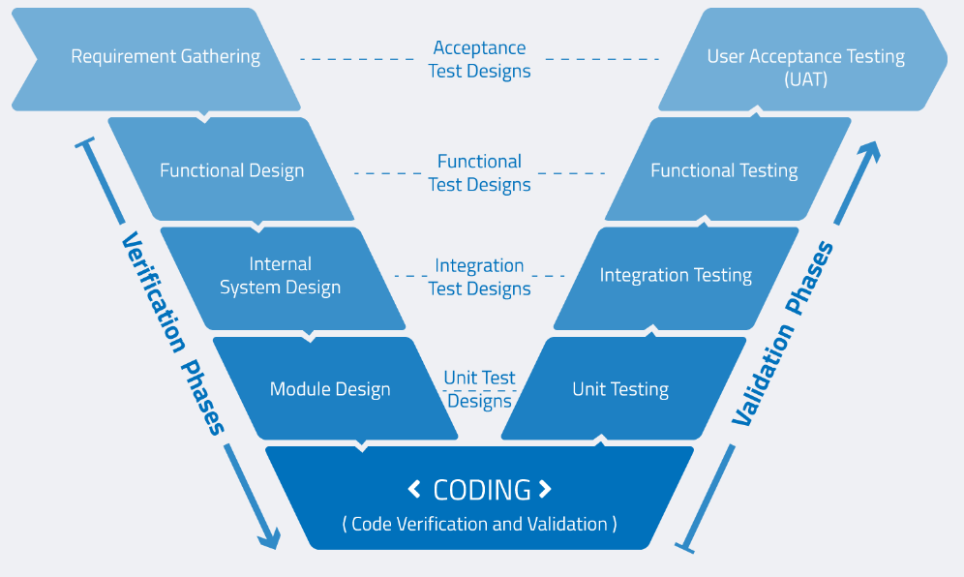
Verification & Validation Model

Slide 33
Software Lifecycle Activities
Requirements
Elicitation
Analysis
System
Design
Object
Design
Implemen-
tation
Testing
Implemented
By
Expressed in Terms Of
Structured By
Realized By
Verified
By
class...
class...
class...
?
?
class....
Use Case
Model
Application
Domain
Objects
Solution Domain
Objects
Subsystems
Source
Code
Test
Cases

Slide 34
Scientist vs Engineer
Computer Scientist
Proves theorems about algorithms, designs languages, defines knowledge representation schemes
Has infinite time…
Engineer
Develops a solution for an application-specific problem for a client
Uses computers & languages, tools, techniques and methods
Software Engineer
Works in multiple application domains
Notes:
A computer scientist assumes that techniques, methodologies and tools are to be developed. They investigate in designs for each of these weapons, and prove theorems that specify they do what they are intended to do. They also design languages that allow us to express techniques. To do all this, a computer scientist has available an infinite amount of time.
A software engineering views these issues as solved. The only question for the software engineer is how these tools, techniques and methodologies can be used to solve the problem at hand. What they have to worry about is how to do it under the time pressure of a deadline. In addition they have to worry about a budget that might constrain the solution, and often, the use of tools. Good software engineering tools can cost up to a couple of $10,000 Dollars (Galaxy, Oracle 7, StP/OMT)
Object modeling is difficult. As we will see, good object modeling involves mastering complex concepts, terminology and conventions. It also requires considerable and sometimes subjective expertise in a strongly experience-based process. Beware of the false belief that technology can substitute for skill, and that skill is a replacement for thinking. offers this advise [cit Tillmann].
Many organizations are frustrated with a lack of quality from their tool-based systems. However, the cause of this problem is often the false belief that a tool can be a substitute for knowledge and experience in understanding and using development techniques. Although CASE tools such as StP/OMT or Objectory and similar tools have the potential to change how people design applications, it is a mistake to think they can replace the skills needed to understand and apply underlying techniques such as object, functional or dynamic modeling. You cannot substitute hardware and software for grayware (brain power) [cit Tillmann]: Buying a tool does not make a poor object modeler a good object modeler. Designers need just as much skill in applying techniques with CASE tools as they did with pen and paper.
Another problem, that is often associated with tool-based analysis is that it is often insufficient or incomplete. Why is that? To a certain extent this problem has always existed. Systems developers are much better at collecting and documenting data than they are at interpreting what these data mean. This in unfortunate, because the major contribution an analysist can bring to system development is the thought process itself. But just as a tool is not a substitute for technique, knowledge and experience, technique skills cannot replace good analysis - people are still needed to think through the problem.
So our message is: Being able to use a tool does not mean you understand the underlying techniques, and understanding the techniques does not mean you understand the problem. In the final analysis, organizations and practitioners must recognize, that methodologies, tools and techniques do not represent the added values of the object modeling process. Rather, the real value that is added, is the thought and insight that only the analyst can provide.

Slide 35
The Software Industry Today
Software Engineering is in Transition
Component-Based Engineering and Integration
Technological Heterogeneity
Enterprise Heterogeneity
Greater potential for Dynamic Evolution
Internet-Scale Deployment
Many competing standards
Much conflicting terminology

Slide 36

Thanks for your attention!
Any Question?
Email me on : junaidakram@cuilahore.edu.pk

